Slide 1
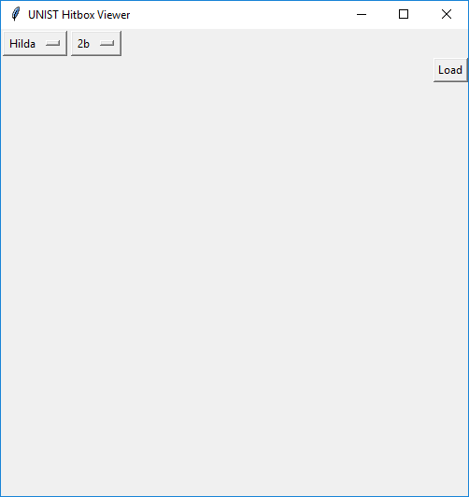
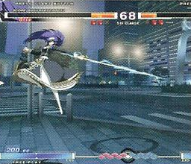

Unist Hitbox Viewer (Barebones)
This program will allow the user to select from a short list of characters and attacks to view the hitboxes for their selection much like the examples below.
Coders: Tyus Carver
Sources: http://effbot.org/tkinterbook/optionmenu.htm
http://effbot.org/tkinterbook/pack.htm
http://www.java2s.com/Code/Python/GUI-Tk/LayoutsideTOPLEFT.htm
Note: Non-working model

